Slide 1
Games and Adversarial Search
Fundamentals of Artificial Intelligence
Slides are mostly adapted from AIMA, MIT Open Courseware and
Svetlana Lazebnik (UIUC)

Slide 2
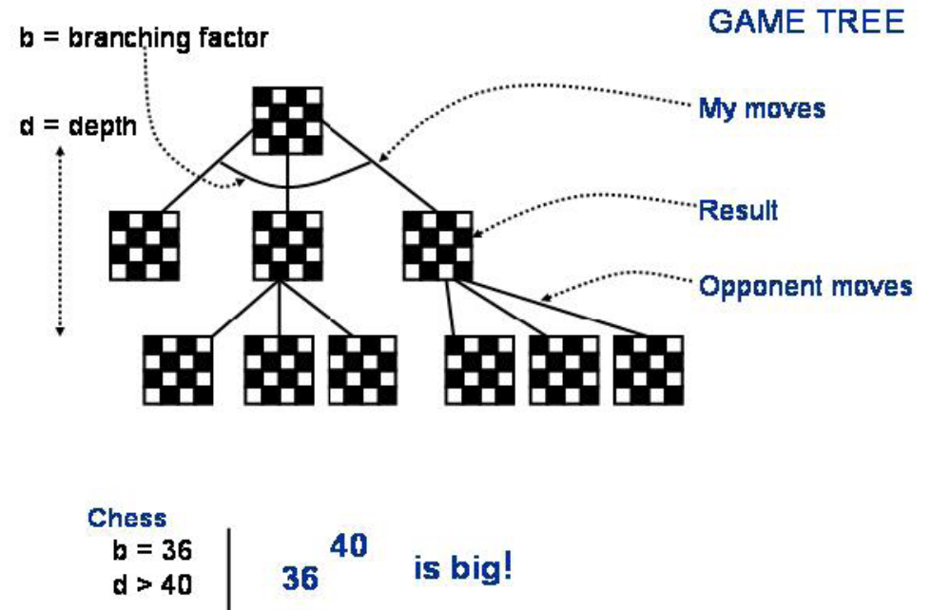
Move generation
Notes:
Recall that, minimax assumes to search till to the terminal states but this is not possible in most of the problems, as in chess

Slide 3
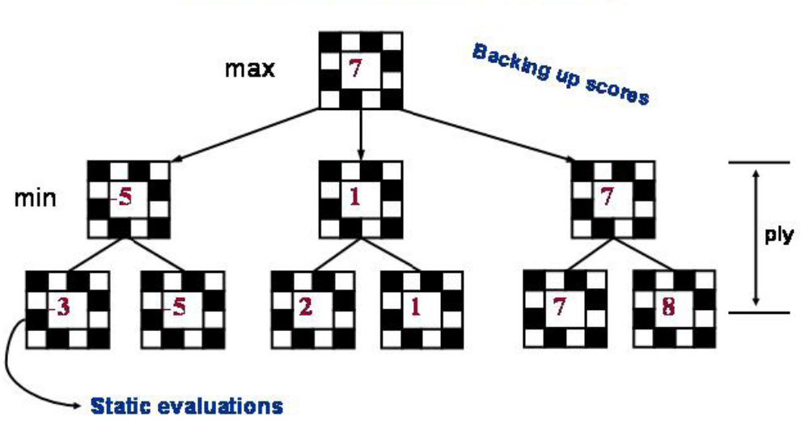
Min-Max
3
Notes:
Shannon, in his original paper, suggested to use heuristic evaluation function to be able to cut in earlier levels.

Slide 4
Resource limits
Suppose we have 100 secs, explore 10⁴ nodes/sec
→ 10⁶ nodes per move
Standard approach:
cutoff test:
  e.g., depth limit (perhaps add quiescence search)
evaluation function
  = estimated desirability of position
Notes:
That is, minimax is changed by replacing the utility function with the evaluation function, and replacing terminal test with cut-off test

Slide 5
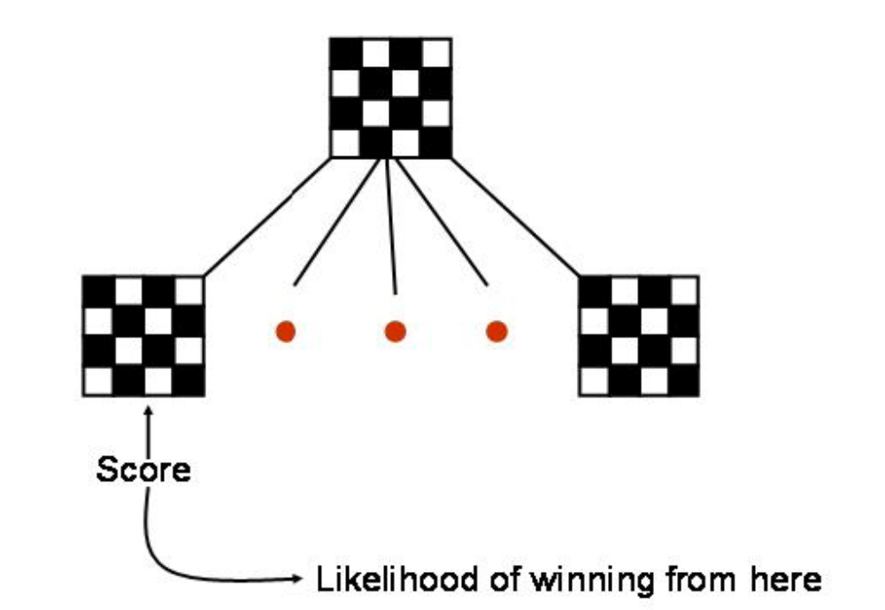
Evaluation function
Notes:
An evaluation function returns as estimate of the expected utility of the game from a given position

Slide 6
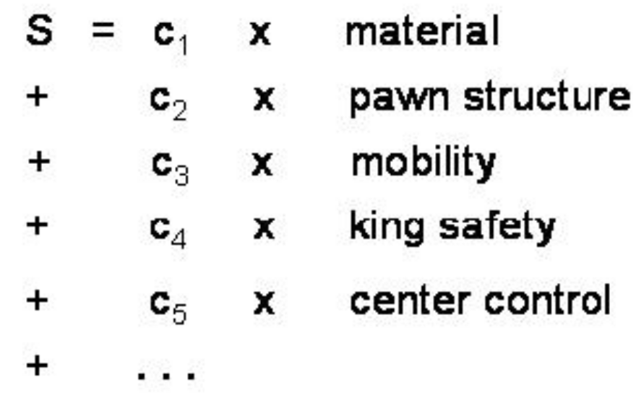
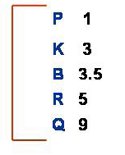
Evaluation function
"material", : some measure of which pieces one has on the board.
A typical weighting for each type of chess piece is shown
Other types of features try to encode something about the distribution of the pieces on the board.
Notes:
For example in chess, we can judge the winning chances of each side based on features of a position
There is an approximate material value for each piece:
Each pawn is worth 1. a knight or bishop is worth 3, a rook 5, and a queen 9
If all the other things are equal, a side that has a secure secure material advantage of a piece will probably will the game.
Other features, such as good pawn structure and king safety can also be considered

Slide 7
Evaluation functions
A typical evaluation function is a linear function in which some set of coefficients is used to weight a number of "features" of the board position.
weighted sum of features:
Eval(s) = w₁ f₁(s) + w₂ f₂(s) + … + w_{n} f_{n}(s)
  For chess, w_{k} may be the material value of a piece (pawn = 1,
  knight = 3, rook = 5, queen = 9) and f_{k}(s) may be the advantage in terms of that piece
  Eg. w₁ = 9 with
f₁(s) = (number of white queens) – (number of black queens)
Notes:
We can use an evaluation function simply as a weighted linear function, where w’s are the weights and f’s are the features of a particular position.
In the simplest case w’s would be the values of pieces and f’s would be the numbers of each kind of piece on the board
If we cut off the search at a particular non-terminal state then we do not know what will happen in subsequent moves.
If evaluation function counts only material value, then in the opening since both sides have the same materials the evaluation will be 0
If MAX manages to capture a bishop without loosing a piece, then the resulting function will have an evaluation value of 3
However, note that a given evaluation value covers many different positions :
All the positions where MAX is up by a bishop are grouped together into a category that is labeled as 3
The evaluation function should reflect the CHANCE that a position chosen at random from such a category leads to a win based on the previous experience

Slide 8
Evaluation function
Cut off search at a certain depth and compute the value of an evaluation function for a state instead of its minimax value
The evaluation function may be thought of as the probability of winning from a given state or the expected value of that state
  If a position A has a 100% chance of winning it should have the evaluation 1
  If position B have a 50% chance of winning and 25% os loosing and 25% of being a draw, the evaluation value would be +1x0.50+ -1x0.25+ 0x0.25 = 0.25
Evaluation functions may be learned from game databases or by having the program play many games against itself
Notes:
The performance of game playing program is dependent on the quality of the evaluation function
If it is inaccurate then it will guide the program toward positions that are apperantly good, but in fact not
How do we measure the quality of the evaluation function?
First, the evaluation function must agree with the utility function on terminal states
Second, it must not take too long
Third, an evaluation function should reflect the actual chances of winning
We should define the evaluation function by the rules of probability to represent the chance of winning
If a position A has a 100% chance of winning it should have the evaluation 1
If position B have a 50% chance of winning and 25% os loosing and 25% of being a draw
The evaluation would be +1x0.50+ -1x0.25+ 0x0.25 = 0.25
The actual numeric values are not important but the evaluation function should reflect that A is rated highed than B
Most game-playing use linear functions that we discussed as an approximation
In constructing the linear functions, we have to pick the features and adjust the weights until the program plays well.
Weights can be automatically learned by letting the program to play lots of games against itself
But it is more difficult to pick the features automatically

Slide 9
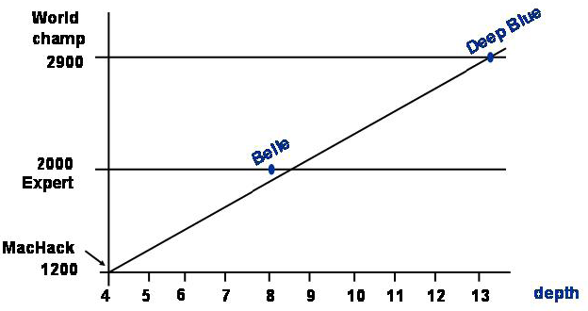
Cutting off search
MinimaxCutoff is identical to MinimaxValue except
  Terminal? is replaced by Cutoff?
  Utility is replaced by Eval
Does it work in practice?
b^{m} = 10⁶, b=35 m=4
4-ply lookahead is a hopeless chess player!
  4-ply ≈ human novice
  8-ply ≈ typical PC, human master
  12-ply ≈ Deep Blue, Kasparov
Notes:
The key idea is that the more lookahead we can do, that is, the deeper in
the tree we can look, the better our evaluation of a position will be,
even with a simple evaluation function.
In some sense, if we could look all the way to the end of the game,
all we would need is an evaluation function that was 1 when
we won and -1 when the opponent won.

Slide 10
Chess playing systems
Baseline system: 200 million node evalutions per move
(3 min), minimax with a decent evaluation function and quiescence search
  5-ply ≈ human novice
Add alpha-beta pruning
  10-ply ≈ typical PC, experienced player
Deep Blue: 30 billion evaluations per move, singular extensions, evaluation function with 8000 features,
large databases of opening and endgame moves
  14-ply ≈ Garry Kasparov
More recent state of the art (Hydra, ca. 2006): 36 billion evaluations per second, advanced pruning techniques
  18-ply ≈ better than any human alive?
Notes:
it seems to suggest that brute-force search is all that matters.
And Deep Blue is brute indeed... It had 256 specialized chess processors coupled into a
32 node supercomputer. It examined around 30 billion moves per minute.
The typical search depth was 13ply, but in some dynamic situations it could go as deep as 30.

Slide 11
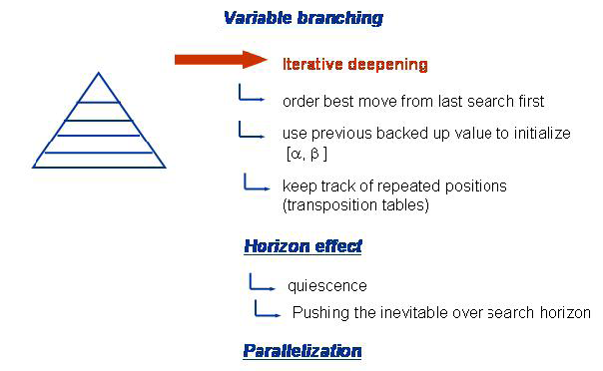
Practical issues
Notes:
The most straightforward approach to control the amount of search is to set a fixed depth limit, so that the cutoff test succeeds for all nodes at or below depth d
The depth is chosen so that the amount of time used will not exceed the allowed time
A better approach would be to apply iterative deepening
When time runs out the program returns the move selected by the deepest completed search
We can initialize alpha and beta values from the previous levels when pruning is applied

Slide 12
Cutting off search
Horizon effect: you may incorrectly estimate the value of a state by overlooking an event that is just beyond the depth limit
  For example, a damaging move by the opponent that can be delayed but not avoided
Possible remedies
  Quiescence search: do not cut off search at positions that are unstable – for example, are you about to lose an important piece?
  Singular extension: a strong move that should be tried when the normal depth limit is reached
Notes:
However, approximate nature of evaluation function may lead to undesired consequences
For example according to material function if white is ahead by a knight and almost certain to win, when it is black’s move if white queen is lost then the position is actually will be a won for black, but without looking 1 more ply we missed this option
It seems that a more sophisticated cutoff test is needed
The evaluation function should be applied to positions that are quiescent (in a state or period of inactivity), that is, unlikely to exhibit wild swings in value in the near future
Nonquiescent positions can be expanded further until quiescent positions are reached
This extra search is called as quiescence search.
The horizon effect arises when the program is facing a move by the opponent that causes serious damage and is ultimately unavoidable
For example when black is slightly ahead in material if white can advance its pawn from the seventh row to the eight, it will become a queen
And will be easy to win for white

Slide 13
Advanced techniques
Transposition table to store previously expanded states
Forward pruning to avoid considering all possible moves
Lookup tables for opening moves and endgames

